Slide 1
The Real Case
using EM Algorithm
DSP - Labs
Notes:
Hello everyone,
In this session, I will share our experience in using EM algorithm in the real world project.

Slide 2
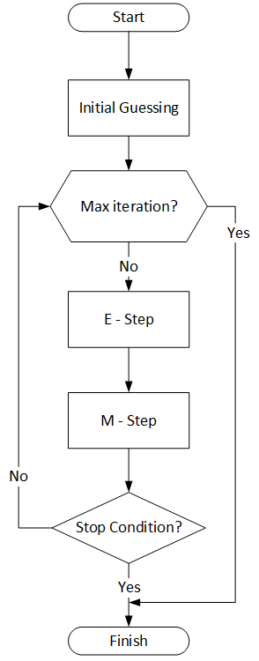
OUTLINE
Introduction
Data Example
Pre-Processing
Initial Guessing
E-Step
M-Step and result
Live Website
Notes:
In this session, I will covers the following:
First, the introduction about the issue we want to solve using EM algorithm.
Second, the example on how the raw data looks like.
In this case, we skip the data cleaning and assume the data is ready to be used in our algorithm
Third, we start preprocessing the raw data to obtain the statistics of the batches.
Forth, fifth and sixth are the EM algorithm itself
And then the last, we will show the illustration of the results in our website and how it can be used by manufacturer to track their machine yield rate.

Slide 3
INTRODUCTION
Outline
EM Overview

Slide 4
PCB Manufacturing Illustration
Outline
EM Overview
Raw
Station W
Station X
Station Y
Station Z
Result
GBOM A
BATCH A1
Mch-1
Mch-5
BATCH A1
A1-1
A1-2
A1-END
BATCH A2
A2-1
A2-2
A2-END
BATCH A2
C1-3
GBOM B
BATCH B1
Mch-2
C1-2
Mch-3
Mch-4
Mch-6
BATCH B1
B1-1
B1-2
B1-3
B1-4
B1-END
C1-4
GBOM C
BATCH C1
C1-5
BATCH C1
C1-1
C1-END
Note: ignore the line pattern/dash
A1-1 → BATCH Name - Step Number
INSPECTIONS
Detect defective pieces
Non inspection machines can’t detect defective pieces
Notes:
Currently, many manufacturers use a batch production system.
Let’s see this illustration, where a manufacture may have 3 recipes to produce 3 types of products, say GBOM A, B, and C.
Then we can say the BATCH are the serving number they need for each GBOM
Manufacture could produce many different product, with the available machines.
In this case, some machines may be used by only one GBOM (e.g. Mch-1),
while the other machines are used by one or several GBOM in any of their sequences
(e.g. Mch-2 that used by GBOM B and C in batch B1 and C1,
or Mch-6 that used by GBOM A, B, and C),
Sometimes, a machine could be used more than once in a BATCH, like Mch-3 in BATCH C1, used in first and fifth steps
Then
Commonly, if any of these machine starts producing defective pieces, the yield rate of one or more BATCHes may falling and will affects the profit.
Because of that, manufacture need to find and fix that machine as soon as possible,
However, In the real world, detecting defective pieces using inspection equipment require cost and time.
Therefore, commonly, only several machine with inspection equipment could detect defective pieces.
So, finding machines that producing defective pieces is rather a difficult task.

Slide 5
BATCH Yield Calculation
Outline
EM Overview
First Pass Yield
INSPECTIONS
Detect defective pieces
BATCH …..
BATCH C1
Mch-3
Mch-2
Mch-4
Mch-6
Mch-3
BATCH C1 Yield
i th BATCH
Pieces = 5
BATCH …..
Mch-3 YR * Mch-2 YR * Mch-4 YR * Mch-6 YR * Mch-3 YR = BATCH C1 Yield Rate
0.99 * ? * ? * 0.95 * 0.99 = 0.9
Unknown yield rate
# of good pieces from X
Machine-X Yield Rate =
# of good pieces from X + # of defective pieces from X
Notes:
One way to find the problematic machines is by using the First Pass Yield estimation.
This is a straightforward method,
That BATCH yield rate is the yield rate multiplication of all machines used by that BATCH
However, even by using this method, It still difficult to find the problematic machine that generate many defective pieces.
For example, manufacturer maybe could estimate the yield rate of machine 3, and 6, because it have inspection equipment.
Then while we know that the yield rate of BATCH C1 is 0.9, which machine has the lowest yield rate? or generate many defective pieces?
We don’t know….
How we compare them, we don’t even have the complete data of the machine yield rates.
Other than that, defective pieces that observe in, say, Mch-6, may be caused by one of the previous machines.
Is Mch-6 really has 0.95 yield rate?

Slide 6
PROBLEM STATEMENT
Outline
EM Overview
how to find which machines generate the most number of defective pieces (lowest machine yield rate)?
Will go to maintenance
To avoid further losses in profit
Notes:
Accordingly, the objective of the manufacturer is
“to find which machines will generate the most number of defective piece (or lowest yield rate)”.
So that they can quickly fix that machines with lowest yield rate.
And avoid further losses in their profit.

Slide 7
Proposed Solution (EM)
Outline
EM Overview
INITIAL GUESSING
machine yield rates (Pm)
Y
stop conditions?
STEP
6
STEP
5
Update Pm
Calculate Gm
M-Step
Gm / (Gm + Zm)
Xm + (Gi * ℕim)
Yield rate estimations
STEP
1
N
E-Step
Summarise Zij and Xij for each machine m (to get Zm and Xm)
BATCH A
BATCH B
…
…
BATCH Z
Xijk + Gi
1.55 + 3
STEP
3
STEP
4
Generated good pieces
Estimate Zijk and Xijk
BATCH…..
j=1
j=2
j=3
j=4
j=5
BATCH C1
Mch-3
4.55
Mch-2
4.15
Mch-4
3.55
Mch-6
3
Mch-3
3
Finished Batch
i th Batch
Pieces = 5
Good Pieces = 3
( Gi )
k = 1
k = 2
k = 3
k = 4
BATCH …..
Defects = 2
at j = 4
suspicious machines
0.45
0.4
0.6
0.55
Mch-3 and Mch-6 can observe defective pieces
Shared defective pieces ( Zijk ) based on each Pm
STEP
2
Notes:
Because we have unknown data such as defective pieces of each machine and the yield rate of each machine
Here we use EM Algorithm to solve the issue,
in the beginning, we need to guess the yield rate of each machine.
We could just use random guessing or a bit more complex algorithm like least square.
Then the objective in each iteration of the EM algorithm, is to update the yield rate of each machine.
The yield rate of each machine (Pm) could be calculated by dividing the number of good pieces generated by that machine (Gm),
With the total number of processed pieces (in this case, the good pieces and defective pieces) generated by that machine (Gm and Zm).
In this case, the good pieces and defective pieces for each machine will be calculated for each machine m is being used.
To get the Zm, we need to estimate the Zijk in step 2,
according to the principle of likelihood,
when the inspection equipment observes defective pieces,
all the previous machines, including the current machine, that are used to process that batch are suspicious machines.
therefore, we expect the shared probability of defective pieces to be distributed among the suspicious machines based on their yield rates.
In this case, it is represented as Zijk.
For example, if we found 2 defective pieces at j=4,
Then we share that 2 pieces to each machine based on their yield rate,
So in this example, we may have Zijk of 0.45, 0.4, 0.6, and 0.55 which the total is 2 pieces.
Later on, we could combine the Zijk for each machine m into Zm, in step 4
Then, to get the Gm, we need to estimate the total good pieces generated by that machine.
In this case, we need to estimate the Xijk for each batch step.
This is the potential defective pieces estimation for each batch.
It means that when machine 3 in the first step generates 4.55 good pieces, at the end of production, only 3 good pieces have been made.
Therefore, we have 1.55 pieces that are still in good condition but will be defective pieces in one of the subsequent steps.
For example, we may get 4.55 good pieces produced by Mch-3 in the first step.
Because the Gi is 3, the Xijk would be 1.55
Later on, we could combine the Xijk for each machine m into Xm, in step 4
Based on this estimation,
We could calculate the total number of good pieces produced by the machine m as in step 5, or we call it Gm.
In this case, the good pieces of machine m are obtained by adding Xm and the Gi, after the Gi is multiplying with the number of machine m used in that batch (Nim).
Finally, we could update the machine yield rates based on good pieces and defective pieces they generate (Pm).
Then we could go to the next iteration with a new or updated Pm.
It will iterate over and over again until stop conditions have been met,
Where no significant changes in machine yield rates, or exceeding maximum iterations.

Slide 8
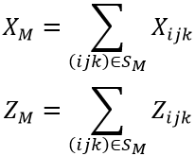
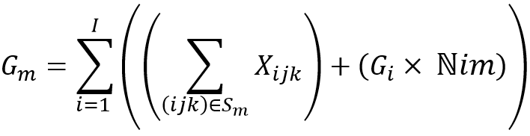

EM Step Overview
E-STEP
m | Name
... 2 3 4 | ... MS-14 SP-06 LK-12 | { … } { B3;1;1, … , C4;3;1} { C4;2;2, C4;3;2 } { B3;2;2, C4;3;3}
BATCH A1, A2, B3, C4
Xijk and Zijk in any observed bad pieces (ij)
STEP
3
Xi3k
Xi31 =
Xi32 + Zi32
Xi32 =
Xi33 + Zi33
Xi33 =
0 + 0
BATCH C4
M=2
M=3
M=4
STEP
4
SUM all X and Z for each machine m
Pieces = 10
or 6 + 4
Zi31
Zi32
Zi33
Gi= 4
Bad Pieces Expectation in Observed BATCH C4 Step 3 (M=4) where j=3
STEP
2
Bij = 6
Zi3k
STEP
5
Good Pieces Expectation
BATCH C4, …, F8
Xijk, Zijk
Bij Zijk Zm Xijk I ℕim Gi Gm Pm Θ | = # of observed bad pieces in jth step of ith BATCH = # of shared bad pieces in a kth machine, where bad pieces is observed at jth step of ith BATCH = Total number of estimated bad pieces generated by machine m = # of good pieces after a kth machine, which will be defective in one of future jth step of ith BATCH = Number of BATCHes = The number of machine m used in batch i (frequency) = Total good pieces in the end of processing of ith BATCH = Number of estimated good pieces of machine m = Yield rate of machine m = Sets of Pm
M-STEP
Θ = { Pm }
Yield rate of machine m
Initial {P(M)}
STEP
1
STEP
6
Update Theta
Pre Processing
Notes:
While The concept has been explained in previous slide,
This slide is a detail view of our EM algorithm.
STEP 1:
The raw data from manufacturer (after data cleaning) will be go through EM Pre Processing to provide the Initial yield rate for each machine (Pm)
E-STEP:
In the E-Step, we will go through all the Batches,
and for each time we found defective pieces, we calculate step 2 and 3.
For example, we found 6 defective pieces (Bij) in Batch C4 in the third machine or step 3
STEP 2:
So, in the step 2 we calculate the Zijk, which are the shared defective pieces for machine 2, 3 and 4.
STEP 3:
Then after that, in step 3, we estimate the Xijk, which is a good pieces other than 4 final good pieces (Gi), which later will be defective pieces
STEP 4:
In step 4, we will combine all Zijk and Xijk that using machine m, so we have the total Zm and Gm for each machine m
STEP 5:
Then is step 5, we could calculate the total Gm for each machine
M-STEP:
STEP 6
after we have the number of good pieces and defective pieces for each machine,
Then in step 6, we could re-calculate the yield rate of each machine. Those values will overwrite the Initial yield rate for each machine (Pm).
Then the process will going back to E-Step using the updated yield rates
This algorithm will run iteratively from E and M Step until the updated yield rate is nearly similar to previous yield rate (converged). Then save the result of converged machine yield rate to report file (database and *.csv)

Slide 9
DATA EXAMPLE
Outline
EM Overview

Slide 10
Data Example
Outline
EM Overview
10
Note: ignore the line pattern/dash
Station W
Station X
Station Y
Station Z
Result
Laser Machine
COI Inspection
Sputtering Machine
Leakage Tester
Finished BATCH
GBOM A
BATCH A1
LS-24
LK-06
BATCH A1
A1-1
A1-2
BATCH A2
A2-1
BATCH A2
A2-2
GBOM B
BATCH B3
MS-14
LK-12
BATCH B3
B3-1
B3-2
GBOM C
BATCH C4
C4-1
BATCH C4
C4-2
C4-3
BATCH C5
MS-28
SP-06
LK-13
BATCH C5
C5-1
C5-2
C5-3
BATCH C6
C6-1
BATCH C6
C6-2
GBOM E
BATCH E7
LS-29
MS-30
SP-07
C6-3
LK-14
BATCH E7
E7-1
E7-2
E7-3
E7-4
F8-2
GBOM F
BATCH F8
F8-3
BATCH F8
F8-1
For simplified case, we use BATCH A1, B3 and C4 as our example in this EM Algorithm
Note: ignore the line pattern/dash
Notes:
We will using this example to estimate the yield rate for each machine
There are many GBOM and Batches in a manufacturer,
But, for simplified case, we use BATCH A1, B3 and C4 as our example in this EM Algorithm

Slide 11
Raw Data
Outline
EM Overview
STEP 1
# | bat_name | bat_machine_step1 | bat_machine_step2 | bat_machine_step3 | bat_step | processed | bad_pieces
0 | BATCH A1 | LS-24 |  |  | 1 | 2 | 0
1 | BATCH A1 | LS-24 | LK-06 |  | -1 | 2 | 1
2 | BATCH B3 | MS-14 |  |  | 1 | 10 | 2
3 | BATCH B3 | MS-14 | LK-12 |  | -1 | 8 | 2
4 | BATCH C4 | MS-14 |  |  | 1 | 10 | 2
5 | BATCH C4 | MS-14 | SP-06 |  | 2 | 8 | 3
6 | BATCH C4 | MS-14 | SP-06 | LK-12 | -1 | 5 | 1
Notes:
Then, based on the previous slide, this is the raw data looks like
We use this ladder type of data because, each batch step, will be affected by all of the previous machines.
So that, this is just to make it easier to calculate the E-step in each batch step.

Slide 12
PRE PROCESSING
Outline
EM Overview

Slide 13
BATCH Information
Outline
EM Overview
STEP 1
Data Structures
# | bat_name | machine_used | bat_total_pieces | bat_good_pieces | bat_yield_rate | ln_bat_yield_rate
1 | BATCH A1 | [ LS-24, LK-06 ] | 2 | 1 | 0.5 | -0.6931
2 | BATCH B3 | [ MS-14, LK-12 ] | 10 | 6 | 0.6 | -0.5108
3 | BATCH C4 | [ MS-14, SP-06, LK-12 ] | 10 | 4 | 0.4 | -0.9162
BATCH’s Information is a data structure to store the stat of each BATCH. Columns values are calculated and stored one by one.
BAT Information
BAT Name
BAT Total Pieces
BAT Name
BAT Good Pieces
Type: 2D Array as Python‘s Dataframe
BAT Name
BAT Yield Rate
Natural Log ( ln ) of BAT Yield Rate
Notes:
In the preprocessing session,
And based on the raw data itself, we could extract the statistics of each batch.
For example
Batch name,
the machine used in each step,
Total raw pieces,
Total good pieces, and
the yield rate of the batch

Slide 14
INITIAL GUESSING
Outline
EM Overview

Slide 15
One Hot: BATCH Machine Usage
Outline
EM Overview
STEP 1
# | bat_name | bat_machine_step1 | bat_machine_step2 | bat_machine_step3 | bat_step | processed | bad_pieces
1 | BATCH A1 | LS-24 | LK-06 |  | -1 | 2 | 1
3 | BATCH B3 | MS-14 | LK-12 |  | -1 | 8 | 2
6 | BATCH C4 | MS-14 | SP-06 | LK-12 | -1 | 5 | 1
Filter
onehot_bat_machine_usage:
# | LS-24 | MS-14 | LK-06 | LK-12 | SP-06
1 | 1 | 0 | 1 | 0 | 0
3 | 0 | 1 | 0 | 1 | 0
6 | 0 | 1 | 0 | 1 | 1
Notes:
Here, In the step 1, we need to guess the initial machine yield rates.
In this case, we use one hot encoding to map the machines that used by each batch.

Slide 16
Machine Information: Initial Yield Rate
Outline
EM Overview
STEP 1
Calculated using Least Square
onehot_bat_machine_usage:
bat_information:
# | LS-24 | MS-14 | LK-06 | LK-12 | SP-06
1 | 1 | 0 | 1 | 0 | 0
3 | 0 | 1 | 0 | 1 | 0
6 | 0 | 1 | 0 | 1 | 1
# | bat_name | ... | ln_bat_yield_rate
1 | BATCH A1 | ... | -0.6931
2 | BATCH B3 | ... | -0.5108
3 | BATCH C4 | ... | -0.9162
X
Y
Least Square
The Initial Machine Yield Rate is calculated using Least Square, where the OneHot BATCH Machine Usage as X And Log (Batch yield rate) as Y.
# | machine_name | ... | init_yield_rate | ln_yield_rate
0 | LS-24 | .... | 0.7071 | -0.3466
1 | MS-14 | .... | 0.7746 | -0.2554
2 | LK-06 | .... | 0.7071 | -0.3466
3 | LK-12 | .... | 0.7746 | -0.2554
4 | SP-06 | .... | 0.6667 | -0.4054
Notes:
Then we use least square to guess the initial machine yield rate.
Here, we use the one hot encoding we already build as the X
And the natural log of batch yield rate as the Y.

Slide 17
Machine Information
Outline
EM Overview
STEP 1
Data Structures
# | machine_name | good_produced | init_yield_rate | ln_yield_rate | em_yield_rate
0 | LS-24 | 1 | 0.7071 | -0.3466 | 0.7071
1 | MS-14 | 10 | 0.7746 | -0.2554 | 0.7746
2 | LK-06 | 1 | 0.7071 | -0.3466 | 0.7071
3 | LK-12 | 10 | 0.7746 | -0.2554 | 0.7746
4 | SP-06 | 4 | 0.6667 | -0.4054 | 0.6667
First, it is same as init_yield_rate. Then, updated in each EM iteration
Machine Information
Machine Name
Machine Good Pieces Produced
Machine’s Information is a data structure to store the stat of each machine. Columns values are calculated and stored one by one.
machine_name is provided from “OneHot Batch Machine Usage” columns
Machine Name
Machine’s Initial Yield Rate
Machine Name
Natural Log ( ln ) of Machine Yield Rate
EM Result of Machine Yield Rate
Type: 2D Array as Python‘s Dataframe
Notes:
Then,
We could create an independent data about the statistics of the machines.
This data will include the machine name, the good pieces produced by the machine (based on the raw data),
And the initial yield rate of each machine (and its natural log), based on the least square we have used previously.

Slide 18
E-STEP
Outline
EM Overview

Slide 19
E-STEP: Expected Number Bad Pieces
Outline
EM Overview
STEP 2
Xijk + Gi
1.55 + 3
STEP
3
Generated good pieces
Estimate Zijk and Xijk
BATCH…..
j=1
j=2
j=3
j=4
j=5
BATCH C1
Mch-3
4.55
Mch-2
4.15
Mch-4
3.55
Mch-6
3
Mch-3
3
Finished Batch
i th Batch
Pieces = 5
Good Pieces = 3
( Gi )
k = 1
k = 2
k = 3
k = 4
BATCH …..
Defects = 2
at j = 4
suspicious machines
0.45
0.4
0.6
0.55
Mch-3 and Mch-6 can observe defective pieces
Shared defective pieces ( Zijk ) based on each Pm
STEP
2
Notes:
Step 2, is the beginning of the E-step.
When we start estimating the Zijk.
So that, when the inspection equipment observes defective pieces,
all the previous machines, including the current machine,
that are used to process that batch are the suspicious machines.
Then we estimate the shared defective pieces based of each machine yield rate (Pm)

Slide 20
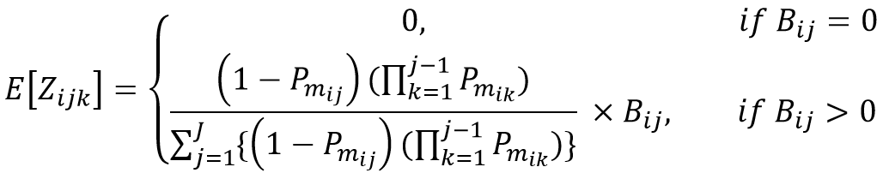
E-STEP: Expected Number Bad Pieces
Outline
EM Overview
STEP 2
When defective pieces is observed,
Calculate shared defective pieces for previous machines including current machine
Z
raw_data:
expected_percent_bad_pieces
[ 0 ]
[ 0.5858, 0.4142 ]
[ 1 ]
[ 0.5635, 0.4365 ]
[ 1 ]
[ 0.4661, 0.5339 ]
[ 0.3757, 0.4303, 0.1940 ]
# | ... | bad_pieces | bat_step_machines
0 | ... | 0 | [ LS-24 ]
1 | ... | 1 | [ LS-24, LK-06 ]
2 | ... | 2 | [ MS-14 ]
3 | ... | 2 | [ MS-14, LK-12 ]
4 | ... | 2 | [ MS-14 ]
5 | ... | 3 | [ MS-14, SP-06 ]
6 | ... | 1 | [ MS-14, SP-06, LK-12 ]
expected_num_bad_pieces
[ 0 ]
[ 0.5858, 0.4142 ]
[ 2 ]
[ 1.1270, 0.8730 ]
[ 2 ]
[ 1.3983, 1.6017 ]
[ 0.3757, 0.4303, 0.1940 ]
*
=
Notes:
Accordingly, we use this formula to estimate the E[Zijk]
Basically, first, we need to calculates the percentage of the probability of each machine of making the pieces defective
Then we multiply the percentage with the number of defective pieces observe in that step.
As a result, we have this Zijk.

Slide 21
E-STEP: Potential defective pieces
Outline
EM Overview
STEP 3
Xijk + Gi
1.55 + 3
STEP
3
Generated good pieces
Estimate Zijk and Xijk
BATCH…..
j=1
j=2
j=3
j=4
j=5
BATCH C1
Mch-3
4.55
Mch-2
4.15
Mch-4
3.55
Mch-6
3
Mch-3
3
Finished Batch
i th Batch
Pieces = 5
Good Pieces = 3
( Gi )
k = 1
k = 2
k = 3
k = 4
BATCH …..
Defects = 2
at j = 4
suspicious machines
0.45
0.4
0.6
0.55
Mch-3 and Mch-6 can observe defective pieces
Shared defective pieces ( Zijk ) based on each Pm
STEP
2
Notes:
In the Step 3, we need to estimate the Xijk for each batch step.
This is the good pieces estimation for each batch step other than the good pieces in the finished product ( Gi ).
We call it as the potential defective pieces because the pieces are in good condition in a particular step,
but will be defective pieces in one of the subsequent steps.
For example when machine 3 in the first step generates 4.55 good pieces, at the end of production, only 3 good pieces have been made.
Therefore, we have 1.55 pieces that are still in good condition but will be defective pieces in one of the subsequent steps.
This 1.55 is the value of the potential defective pieces.

Slide 22

E-STEP: Potential defective pieces
Outline
EM Overview
STEP 3
Potential bad pieces [k] = bad pieces expectation[k+1] + Potential bad pieces [k+1]
Last machine always get 0 (there is no next machine or [k+1] )
raw_data:
# | ... | bat_step_machines
0 | ... | [ LS-24 ]
1 | ... | [ LS-24, LK-06 ]
2 | ... | [ MS-14 ]
3 | ... | [ MS-14, LK-12 ]
4 | ... | [ MS-14 ]
5 | ... | [ MS-14, SP-06 ]
6 | ... | [ MS-14, SP-06, LK-12 ]
expected_num_bad_pieces
[ 0 ]
[ 0.5858, 0.4142 ]
[ 2 ]
[ 1.1270, 0.8730 ]
[ 2 ]
[ 1.3983, 1.6017 ]
[ 0.3757, 0.4303, 0.1940 ]
0.1940 + 0 = 0.1940
potential_bad_pieces
[ 0 ]
[ 0.4142, 0 ]
[ 0 ]
[ 0.8730, 0 ]
[ 0 ]
[ 1.6017, 0 ]
[ 0.6243, 0.1940, 0 ]
0.4303 + 0.1940 = 0.6243
Notes:
Accordingly, we use this formula to estimate the Xijk
The Potential defective pieces in current step,
is the sum of bad pieces expectation and Potential defective pieces in the next step.

Slide 23
E-STEP: SUM Good Pieces & Bad Pieces
Outline
EM Overview
STEP 4
SUM the current expected number of bad pieces & potential defective pieces for each machine m. Later, it can be used to calculate the expected number of good pieces
This step is done inside iteration of batch step (data rows).
So to calculate it, it is cumulated for each row
Example for machine SP-06:
When iterations are in row 0-4:
SUM value = 0 + 0 = 0
When iteration is in row 5:
SUM value = 0 + 1.6017 = 1.6017
When iteration is in row 6:
SUM value = 1.6017 + 0.4303 = 2.0320
# | ... | bat_step_machines
0 | ... | [ LS-24 ]
1 | ... | [ LS-24, LK-06 ]
2 | ... | [ MS-14 ]
3 | ... | [ MS-14, LK-12 ]
4 | ... | [ MS-14 ]
5 | ... | [ MS-14, SP-06 ]
6 | ... | [ MS-14, SP-06, LK-12 ]
expected_num_bad_pieces
[ 0 ]
[ 0.5858, 0.4142 ]
[ 2 ]
[ 1.1270, 0.8730 ]
[ 2 ]
[ 1.3983, 1.6017 ]
[ 0.3757, 0.4303, 0.1940 ]
potential_bad_pieces
[ 0 ]
[ 0.4142, 0 ]
[ 0 ]
[ 0.8730, 0 ]
[ 0 ]
[ 1.6017, 0 ]
[ 0.6243, 0.1940, 0 ]
# | machine_name | ... | expected_num_bad_pieces | potential_bad_pieces
0 | LS-24 | ... | 0.5858 | 0.4142
1 | MS-14 | ... | 6.9010 | 3.0990
2 | LK-06 | ... | 0.4142 | 0
3 | LK-12 | ... | 1.0670 | 0
4 | SP-06 | ... | 2.0320 | 0.1940
M | Name
... 2 3 4 | ... MS-14 SP-06 LK-12 | { … } { B3;1;1, … , C4;3;1} { C4;2;2, C4;3;2 } { B3;2;2, C4;3;3}
Notes:
Then after we have the Xijk and Zijk,
We could combine the Xijk and Zijk of each machine m into Xm and Zm, respectively
As a result, we have the total of expected number of defective pieces and the potential defective pieces each machine m

Slide 24
E-STEP: Expected Number Good Pieces
Outline
EM Overview
STEP 5
Calculate the number of good pieces produced by machine based on the good pieces expectation
# | machine_name | ... | good_produced | ... | potential_bad_pieces
0 | LS-24 | ... | 1 | ... | 0.4142
1 | MS-14 | ... | 10 | ... | 3.0990
2 | LK-06 | ... | 1 | ... | 0
3 | LK-12 | ... | 10 | ... | 0
4 | SP-06 | ... | 4 | ... | 0.1940
+
# | machine_name | expected_num_good_pieces
0 | LS-24 | 1.4142
1 | MS-14 | 13.0990
2 | LK-06 | 1
3 | LK-12 | 10
4 | SP-06 | 4.1940
Xijk I ℕim Gi Gm Sm | = # of good pieces after a kth machine, which will be defective in one of future jth step of ith BATCH = Number of BATCHes = The number of machine m used in batch i (frequency) = Total good pieces in the end of processing of ith BATCH = Number of estimated good pieces of machine m = Set of ijk indexes using machine m
Notes:
Finally, we could calculate the expected number of good pieces of each machine,
By summing the good produced and potential bad pieces produced by each machine.
The good pieces produced column, is obtained from the multiplication of Gi and Nim

Slide 25
M-STEP
Outline
EM Overview

Slide 26

M-STEP: Updated Yield Rate
Outline
EM Overview
STEP 6
# | machine_name | expected_num_bad_pieces | expected_num_good_pieces
0 | LS-24 | 0.5858 | 1.4142
1 | MS-14 | 6.9010 | 13.0990
2 | LK-06 | 0.4142 | 1
3 | LK-12 | 1.0670 | 10
4 | SP-06 | 2.0320 | 4.1940
# | machine_name | SUM | Yield rate equation | em_yield_rate
0 | LS-24 | 2 | 1.4142 / 2 = | 0.7071
1 | MS-14 | 20 | 13.0990 / 20 = | 0.6549
2 | LK-06 | 1.4142 | 1 / 1.4142 = | 0.7071
3 | LK-12 | 11.0670 | 10 / 11.0670 = | 0.9036
4 | SP-06 | 6.2260 | 4.1940 / 6.2260 = | 0.6736
First iteration
Notes:
Finally, we could update the machine yield rates (Pm) based on good pieces (Gm) and defective pieces (Zm) they generate
This is the result in the first iteration

Slide 27
Stopping condition
Outline
EM Overview
STEP 6
Applying stop condition (if theta (last yield rate – current yield rate) is less than the tolerance… or … end of max iteration
If stop condition is not meets, then update the last yield rate from current yield rate and going to next iteration
Iter | EM RESULT | Δ (MSE)
 | LS-24 MS-14 LK-06 LK-12 SP-06
0 | 0.7071 0.6550 0.7071 0.9036 0.6736 | 0.1761
1 | 0.7071 0.5942 0.7071 0.9634 0.7303 | 0.1024
2 | 0.7071 0.5627 0.7071 0.9873 0.7817 | 0.0648
3 | 0.7071 0.5459 0.7071 0.9958 0.8209 | 0.0435
... | ... | ...
27 | 0.7071 0.5062 0.7071 1.0000 0.9702 | 0.0011
28 | 0.7071 0.5059 0.7071 1.0000 0.9712 | 0.0010
29 | 0.7071 0.5057 0.7071 1.0000 0.9721 | 0.0009
Notes:
Then we could go to the next iteration with a new or updated Pm.
It will iterate over and over again until stop conditions have been met,
Where no significant changes in machine yield rates, or exceeding maximum iterations.

Slide 28
RESULT
Outline
EM Overview
Since in the real example, some machine can’t detect or observe bad pieces, thus, the objective of the company is “how to find which machines will generate the most number of bad piece (lowest yield rate)?”
So here we could use EM Algorithm to solve the problem, and we get the result like this:
Iter | EM RESULT (Machine Yield Rate) | Diff
 | LS-24 MS-14 LK-06 LK-12 SP-06
29 | 0.7071 0.5057 0.7071 1.0000 0.9721 | 0.0009
Notes:
In the end, we have the answer to the manufacturer issue to find the machine with the lowest yield rate.
For example
when iteration has been stopped at the 29th iteration
And based on the estimation, the machine with the lowest yield rate is the MS-14
This is the end of the EM algorithm explanation.

Slide 29
LIVE WEBSITE
Outline
EM Overview

Slide 30
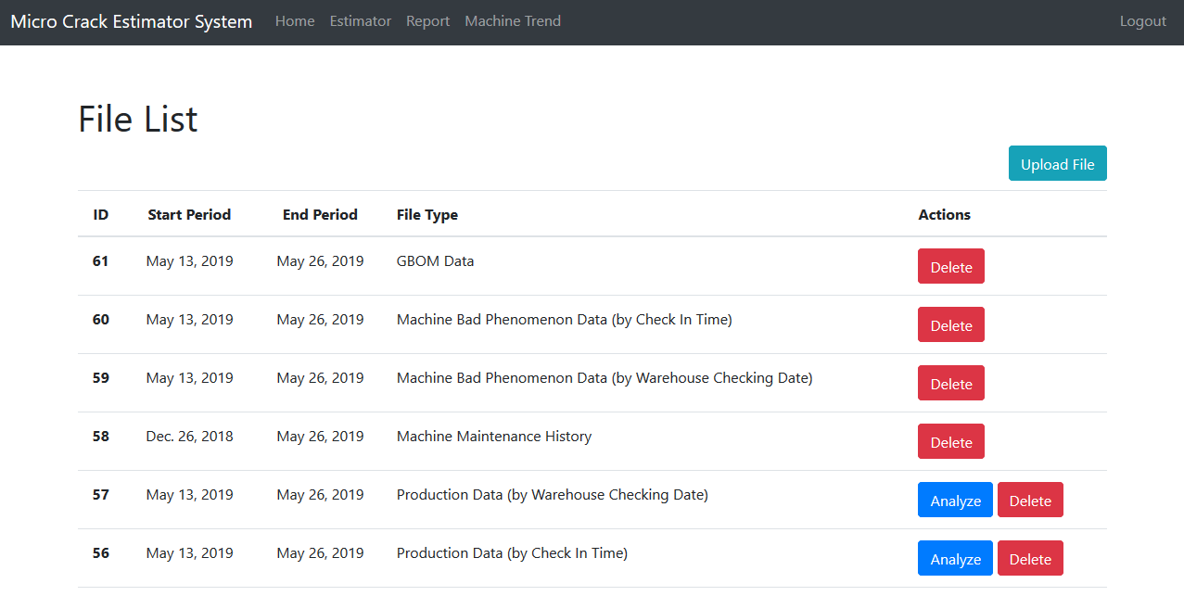
Outline
EM Overview
Notes:
In our project, we create a private website for a manufacturer.
So, that the manufacturer could upload their raw data to us,
Which later we will provide the estimation of the machine yield rates.

Slide 31
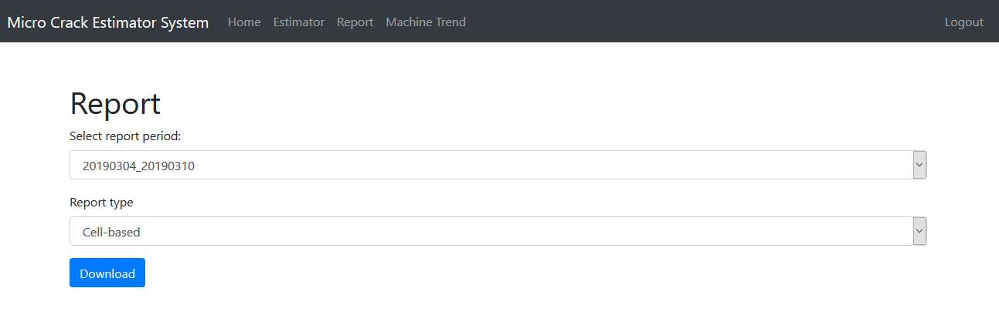
Outline
EM Overview
Notes:
After we estimate the machine yield rate
Then they could download the result and used for their decision making in maintenance session

Slide 32
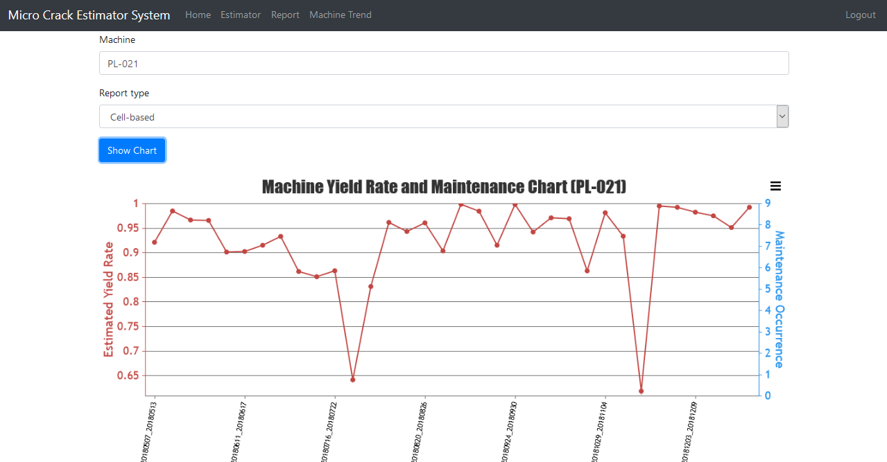
Outline
EM Overview
Notes:
Other than that, we also provide the historical data of the machine yield rate.
So that the manufacturer could monitor their machine yield rate,
And quickly inspect and maintenance their machine, which have lower yield rate.
As a result, we hope that the manufacturer profit could be improved,
Because the future batch yield rate might be increased.

Slide 33
This is the end of presentation.
Thank you
Notes:
This is the end of my explanation about the usage of EM algorithm in real world project.
I hope that you could understand how the EM algorithm works.
thank you and see you next time.

